Slide 1

Evaluating Offensive Tools with Ball Tracking Data
By Reece Calvin
Northeastern University Sports Analytics Club

Slide 2
Offensive Tools
Swing Decision
Contact
Power
Speed
Notes:
We’ll be looking at four main tools: Swing Decision, Contact, Power, and Speed.

Slide 3
Offensive Tools
Swing Decision
Contact
Power
Speed
Notes:
Swing Decision is all about judging pitches and their potential value.
Imagine there is a slow pitch right down the middle, great value in swinging, bad value in taking
105 mph pitch clipping the top corner of the zone. Early in the count, probably a little best off taking
With 2-strikes, could probably see a little surplus value swinging at it
Lastly, a pitch in the dirt. Great value in taking, bad value in swinging

Slide 4

Swing Decision
Objectives:
Judge each pitch based on its velo, movement, count, and location
Score the pitch based on the expected run value
Punish hitters for swinging at bad pitches
Reward hitters for swinging at good pitches
Notes:
To evaluate batters, first, each pitch is assigned a swing Value, take Value, and an overall pitch Value
These metrics are based on a given pitches velo, movement, location and the count
Each pitch also gets a swing probability and an independent called ball vs strike probability, given the pitch was taken
If I don’t make sense, we have more intuitive graphics in a minute

Slide 5
Swing Decision Models
Swing Value
Maps to the expected run value of each
Swing Prob.
Likelihood the average batter will swing at
Called Strike Prob.
Odds pitch is called a strike based on the
pitch location, given the player does not
swing
a pitch, based on pitch characteristics
Outputs probability of each possible
result given Swing
result and sums to a final expected run
value
Notes:
To evaluate a player’s swing decisions, we need three models
Swing Value
Outputs the probability of each possible swing outcome. Thing whiff, foul, ground ball single, fly ball double, etc.
Then, we paired each probability with its respective run value and summed it up for a final expected run value given a swing.
Next, a Swing Probability model was created
Predicted, again off the pitch characteristics, the probability the average batter would would swing at a given pitch
Thirdly, we used a called strike model which outputted to likelihood of a ball being called a strike given there was not swing

Slide 6
Swing Decision Variables and Formulas
Ball Value
Strike Value
Run-Value of a Strike, acknowledging the count
Pitch Value
.$Swing Prob. ∗Swing Value+$
.𝑆𝑤𝑖𝑛𝑔 𝑃𝑟𝑜𝑏. ∗𝑆𝑤𝑖𝑛𝑔 𝑉𝑎𝑙𝑢𝑒+
Outputs Run-Value of a Ball, acknowledging the count
Take Value
$Strike Value ∗Strike Prob. +$ $Ball Value∗Ball Prob.$
𝑆𝑡𝑟𝑖𝑘𝑒 𝑉𝑎𝑙𝑢𝑒 ∗𝑆𝑡𝑟𝑖𝑘𝑒 𝑃𝑟𝑜𝑏. + 𝐵𝑎𝑙𝑙 𝑉𝑎𝑙𝑢𝑒∗𝐵𝑎𝑙𝑙 𝑃𝑟𝑜𝑏.
.$Take Value ∗(1−Swing Prob)$
.𝑇𝑎𝑘𝑒 𝑉𝑎𝑙𝑢𝑒 ∗(1−𝑆𝑤𝑖𝑛𝑔 𝑃𝑟𝑜𝑏)
Notes:
Next, we have four simple yet essential Variables and Formulas.
Ball and Strike value, the run value of a ball/strike given the current count
Take Value, the expected value of taking a pitch based on the ball and strike value, weighted in accordance to the strike probability model from earlier
Lastly, we have a holistic pitch value, which predicts the expected run value by looking at the previously described swing value and take value, this time each weighted by the swing probability

Slide 7
How is the Final Score Calculated
Swing Decision Grade is:
If the hitter swings
If the Hitter Takes
Swing Value – Pitch Value
Take Value – Pitch Value
Notes:
Here is the part that actually matter. For each pitch, if a hitter swings, their value is the difference between the swing value and pitch value. If the hitter takes, they are given the difference between the take value and the pitch value.

Slide 8
Swing Decisions Leaders
 | Name | 2023 Grade | 2024 Grade
1 | Marcus Semien | 70 | 70
2 | Chris Taylor | 70 | -
3 | Brandon Belt | 65 | -
4 | Kyle Tucker | 70 | 70
5 | J. D. Davis | 65 | 65
6 | Edouard Julien | 65 | 65
7 | Juan Soto | 65 | 70
8 | Corey Seager | 65 | 65
9 | Andrew Mccutchen | 65 | 70
10 | George Springer | 65 | 70
 | Name | 2023 Grade | 2024 Grade
1 | Kyle Tucker | 70 | 75
2 | George Springer | 70 | 70
3 | Andrew Mccutchen | 65 | 70
4 | Juan Soto | 70 | 70
5 | Dansby Swanson | 65 | 70
6 | Marcus Semien | 70 | 70
7 | Corey Seager | 70 | 65
8 | Gleyber Torres | 60 | 65
9 | Mike Tauchman | 65 | 65
10 | Fernando Tatís | 55 | 60

Slide 9
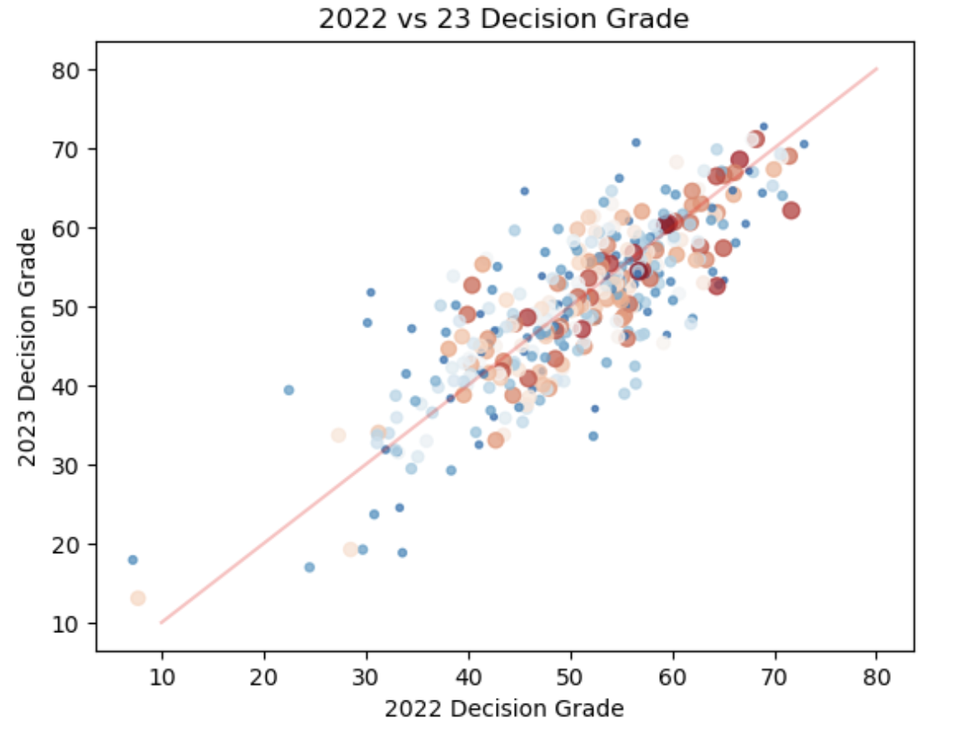
Check Out That Stickiness
Notes:
,61 r2

Slide 10
Offensive Tools
Swing Decision
Contact
Power
Speed

Slide 11


Contact
Contact
Objectives:
Judge a player's ability to make contact when they swing
Do not factor in swing decision

Slide 12
Contact Score
xContact
Given a player swings, odds they make contact with the ball
Contact Score
Made Contact: Score = 1-xContact
Swing-and-Miss:
Score = 0-xContact

Slide 13
Contact Leaders
 | Name | 2023 Grade | 2024 Grade
1 | Luis Arráez | 75 | 70
2 | Keibert Ruiz | 70 | 75
3 | Nico Hoerner | 70 | 70
4 | Steven Kwan | 70 | 70
5 | Alejandro Kirk | 65 | 55
6 | José Ramírez | 65 | 65
7 | Mauricio Dubón | 65 | 60
8 | Miguel Rojas | 65 | -
9 | Jeff Mcneil | 65 | 65
10 | Josh Naylor | 65 | 55
 | Name | 2023 Grade | 2024 Grade
1 | Keibert Ruiz | 70 | 75
2 | Luis Arráez | 75 | 70
3 | Steven Kwan | 65 | 70
4 | Isiah Kiner-Falefa | 60 | 70
5 | Nico Hoerner | 70 | 70
6 | Bo Bichette | 60 | 65
7 | Jeff Mcneil | 65 | 65
8 | Yandy Díaz | 55 | 65
9 | José Ramírez | 65 | 65
10 | Alex Bregman | 65 | 65

Slide 14
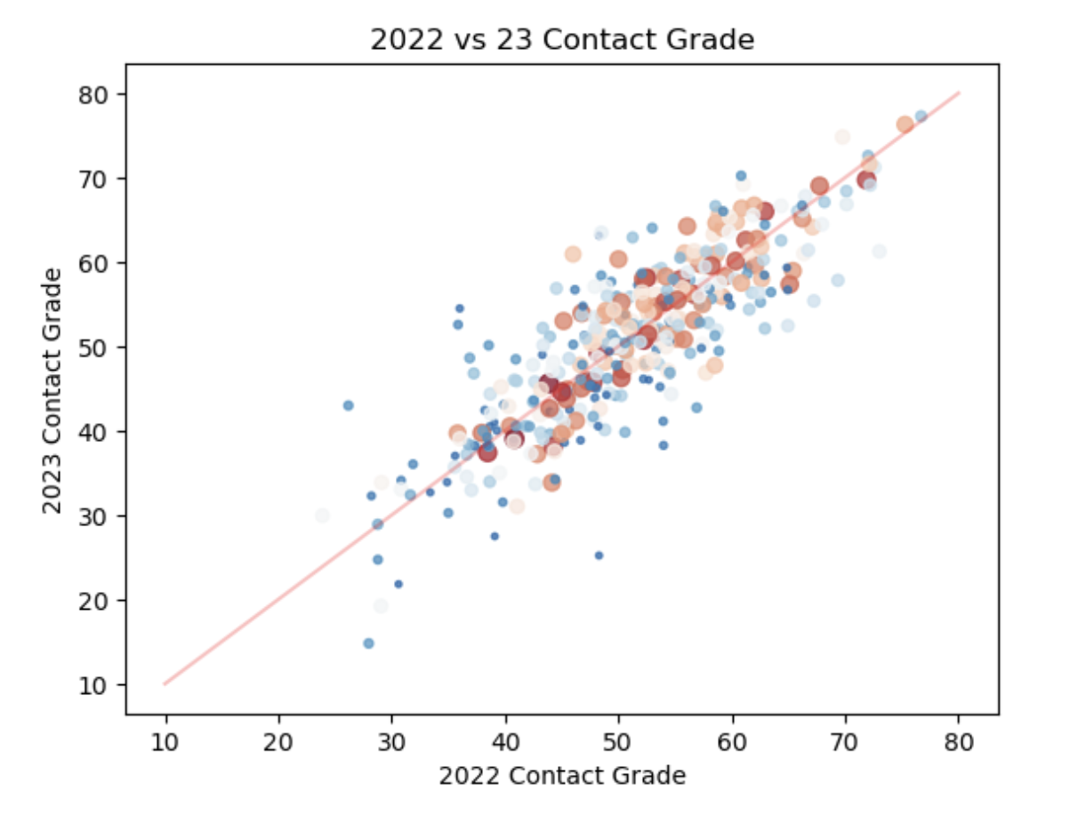
Notes:
.66 R2

Slide 15
Offensive Tools
Swing Decision
Contact
Power
Speed

Slide 16

Power
Objectives:
Exit Velocity over Expected EV, Given contact
Evaluated at a player's 95th percentile output
Notes:
Expected exit velocity is predicted based on the pitch characteristics and launch angle. The difference between realized EV and xEV is accredited towards the batter

Slide 17
Power Leaders
 | Name | 2023 Grade | 2024 Grade
1 | Aaron Judge | 80 | 75
2 | Rafael Devers | 75 | 65
3 | Shohei Ohtani | 75 | 70
4 | Giancarlo Stanton | 75 | 75
5 | Joey Gallo | 70 | 60
6 | Jake Burger | 70 | 65
7 | Ronald Acuña | 70 | 60
8 | Pete Alonso | 70 | 60
9 | Shea Langeliers | 65 | 65
10 | Elly De La Cruz | 65 | 65
 | Name | 2023 Grade | 2024 Grade
1 | Giancarlo Stanton | 75 | 75
2 | Aaron Judge | 80 | 75
3 | Shohei Ohtani | 75 | 70
4 | Ketel Marte | 60 | 70
5 | Anthony Santander | 65 | 70
6 | Salvador Pérez | 60 | 65
7 | Kyle Schwarber | 65 | 65
8 | Joc Pederson | 60 | 65
9 | Vladimir Guerrero | 65 | 65
10 | Rafael Devers | 75 | 65

Slide 18
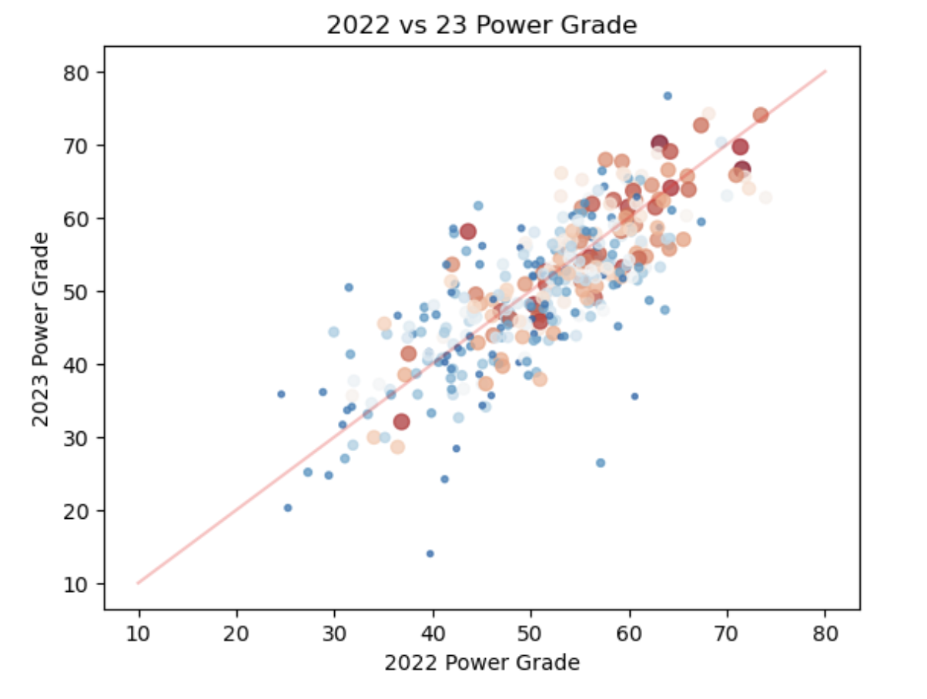

Slide 19
Offensive Tools
Swing Decision
Contact
Power
Speed

Slide 20
Speed Leaders
 | Name | 2023 Grade | 2024 Grade
1 | Corbin Carroll | 70 | 70
2 | Bobby Witt | 70 | 70
3 | Elly De La Cruz | 70 | 65
4 | Myles Straw | 70
5 | Trea Turner | 70 | 65
6 | Cody Bellinger | 70 | 65
7 | Jarren Duran | 65 | 70
8 | Jeff Mcneil | 65 | 60
9 | Shohei Ohtani | 65 | 70
10 | José Siri | 65 | 65
 | Name | 2023 Grade | 2024 Grade
1 | Corbin Carroll | 70 | 70
2 | Bobby Witt | 70 | 70
3 | Shohei Ohtani | 65 | 70
4 | Byron Buxton | 65 | 70
5 | Jarren Duran | 65 | 70
6 | Mj Melendez | 60 | 65
7 | Cody Bellinger | 70 | 65
8 | Brice Turang | 65 | 65
9 | José Siri | 65 | 65
10 | Bryson Stott | 65 | 65

Slide 21
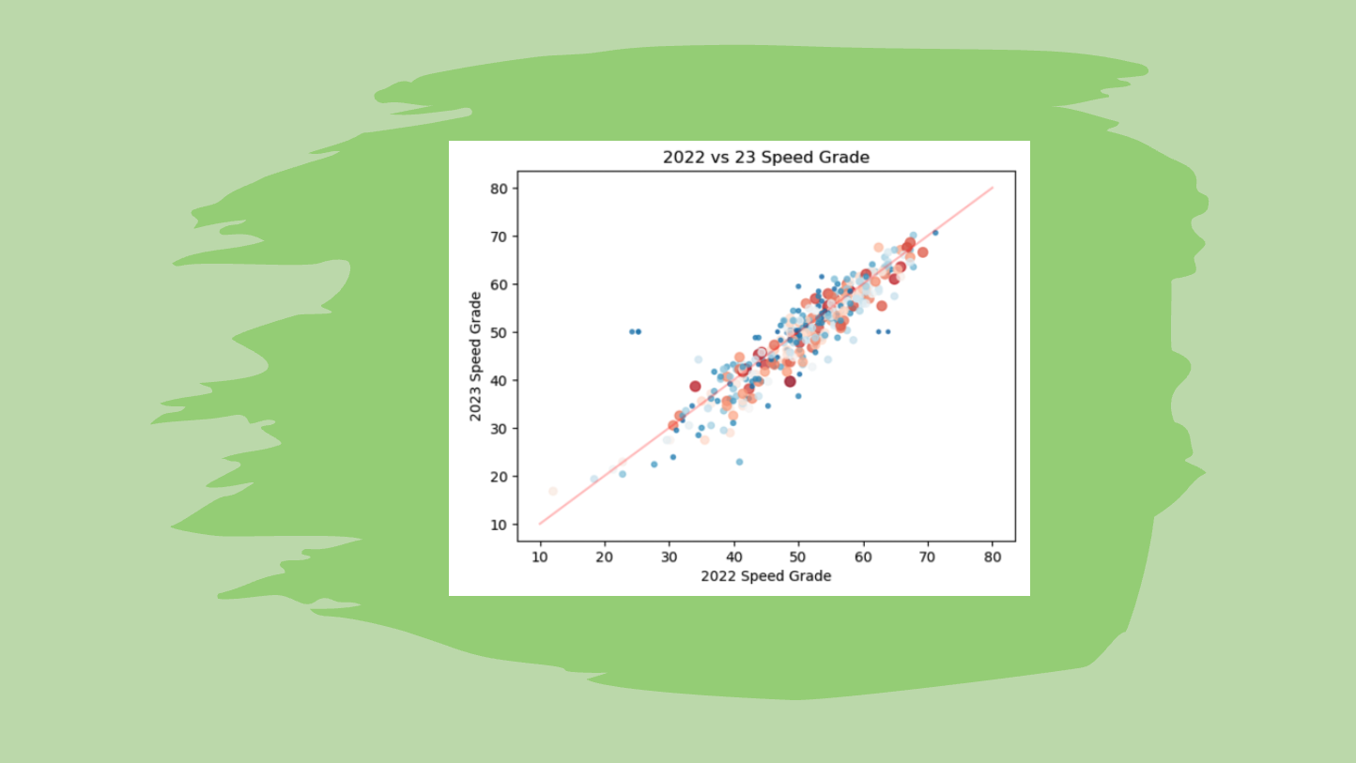
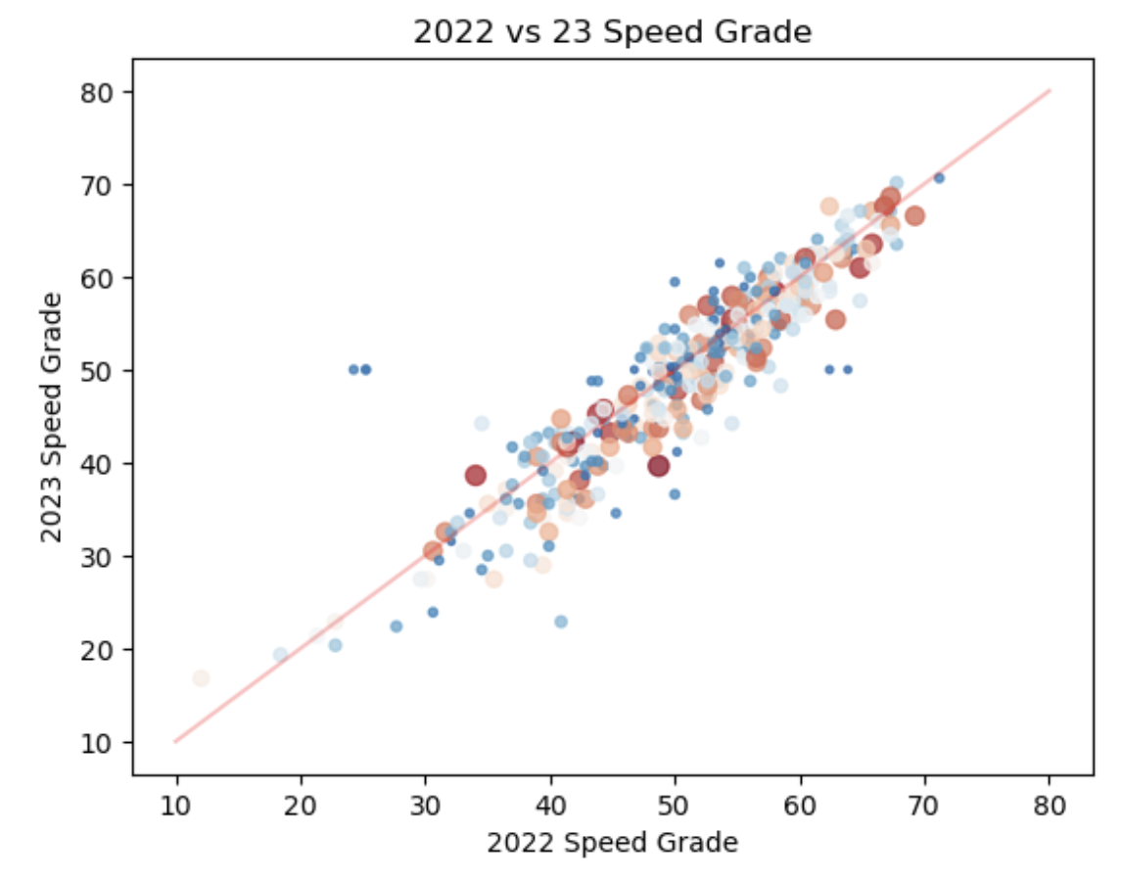

Slide 22
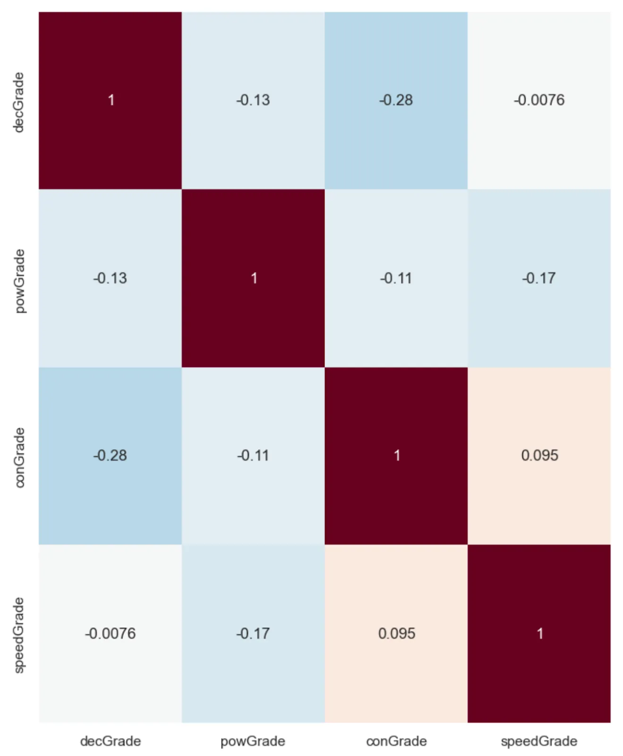
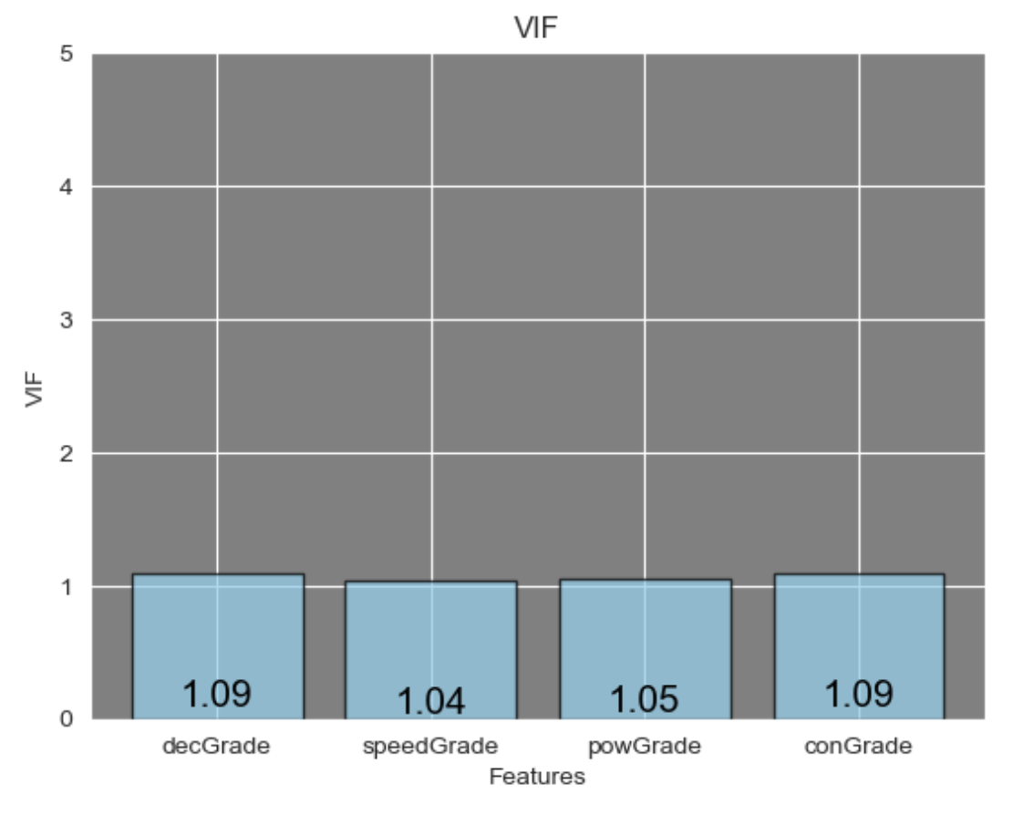

Slide 23
Predicting wOBA
Using linear regression to predict future wRC+
40% Power Grade
28% Decision Grade
24% Contact Grade
8% Speed Grade
Notes:
Using a linear regression model trained on 2018 data, we came to these weights.

Slide 24
Pre-July 2023 Stats | Post July 2023 R²
Tool Grade | .21
Steamer | .25
Process+ | .18
wRC+ | .13
Min 500 pitches N = 206
Notes:
Pitcher plus

Slide 25
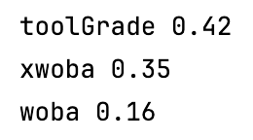
Pre-July Surplus Value
2024 Players
to Watch
wOBA +/- 30 Points off Expectation from Tool Grade
George Springer
Jesús Sánchez
Oneil Cruz
Manuel Margot

Slide 26
Overall Tool Leaders and Laggers
 | Name | 2023 Grade | 2024 Grade
1 | Juan Soto | 55 | 60
2 | Ketel Marte | 55 | 60
3 | Mike Trout | 55 | 60
4 | Shohei Ohtani | 60 | 60
5 | Aaron Judge | 60 | 60
6 | Rafael Devers | 60 | 60
7 | Ronald Acuña | 60 | 55
8 | Fernando Tatís | 55 | 55
9 | José Ramírez | 55 | 55
10 | Yandy Díaz | 55 | 55
 | Name | 2023 Grade | 2024 Grade
1 | Michael Siani |  | 35
2 | Tim Anderson | 40 | 35
3 | Jacob Young |  | 40
4 | Cavan Biggio | 50 | 40
5 | Christian Vázquez | 40 | 40
6 | Kevin Kiermaier | 45 | 40
7 | Wilmer Flores | 50 | 40
8 | Adam Frazier | 40 | 40
9 | Ezequiel Tovar | 40 | 40
10 | Luis Campusano |  | 40

Slide 27
Could We Simplify It?
Swing Decision
K%-BB%
Contact
Whiff%
Power
95th Exit Velocity
Speed
Home to 1st Time

Slide 28
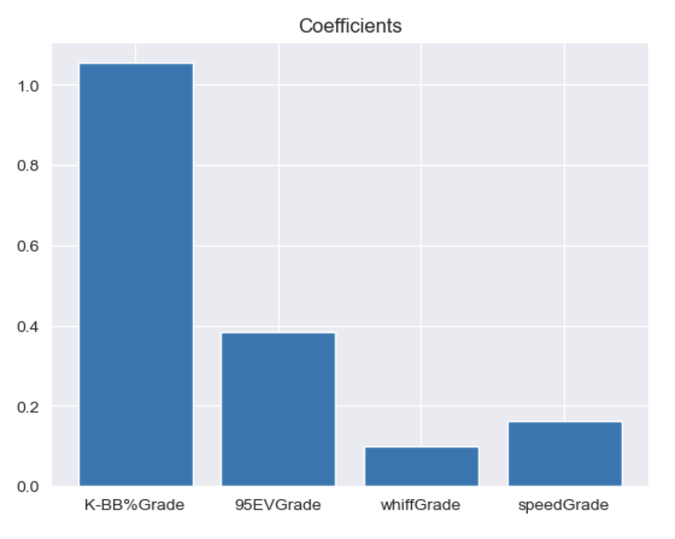
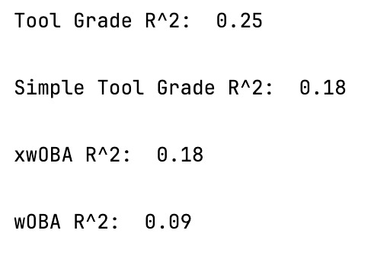
No.

Slide 29
That’s All I Got.
calvin.r@northeastern.edu

